Slide 1

Better Business Regulation
Evaluate the way you regulate
Euan Lockie
Australian Continuous Improvement Group
Mary Stanley
Department of Justice
Victoria

Slide 2
Better Business Regulation
Developed by Department of Justice, Victoria
Linked to reducing regulatory burden
Aimed at quality of regulation
‘Better practices’ framework
Basis – Victorian Guide to Regulation, national and international best practice regulation guides and research

Slide 3
Better Business Regulation
Examine the effectiveness and efficiency of regulatory processes
Identify gaps between current performance and good practices
Practical measures to improve performance

Slide 4
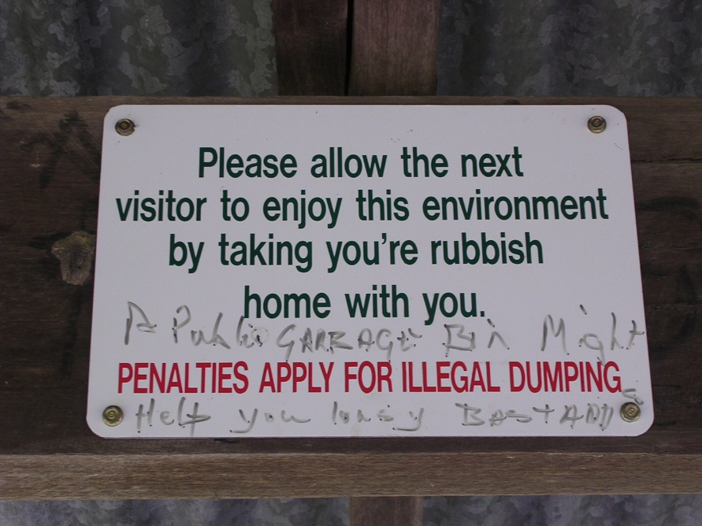
Benefits to community
Regulatory safeguards are provided efficiently & effectively
Regulations achieve the intended results without imposing excessive burdens on individuals and businesses

Slide 5
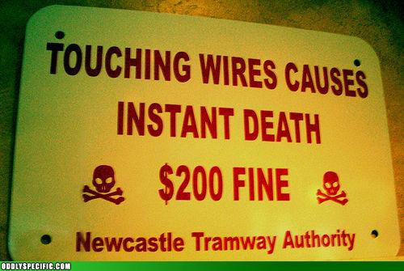
Principles of good regulation
Consistency
Proportionality
Efficiency
Effectiveness
Transparency
Accountability
Image: oddlyspecific.com http://failblog.org/tag/oddly-specific/

Slide 6
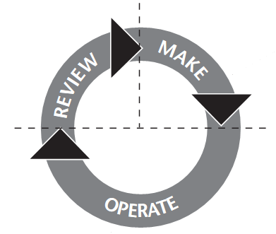
The regulatory lifecycle

Slide 7
The regulatory lifecycle
COORDINATE

Slide 8
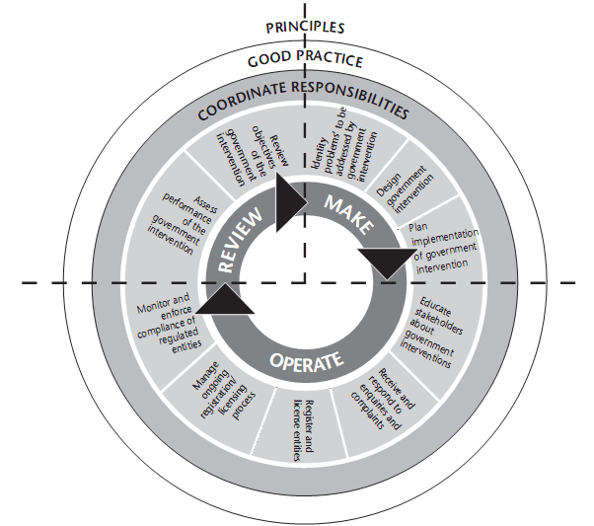
Make
  Identify ‘problems’
  Design regulatory intervention
  Plan implementation
Operate
  Educate stakeholders
  Respond to enquiries
  Register/license persons & entities
  Respond to complaints
  Manage continuing registration/licensing
  Monitor & enforce compliance
Review
  Assess intervention performance
  Review objectives
Coordinate
  Between agencies
  Within agencies
Notes:
13 Activities

Slide 9

Stages
Develop framework March 2007
Pilot two regulators October 2007
Implement pilot findings February 2008
BBR self-evaluations by DoJ regulators 2008/9
BBR self-evaluations by DPI regulators 2010

Slide 10
“What’s in it for us?”
An analysis of internal ‘regulatory’ practices and processes.
Identification of improvement opportunities.
Evidence for decision making, strategic planning and implementing improvements.
Opportunities prioritised by the regulator progressively implemented.

Slide 11
Self-evaluation steps
Plan & brief
Collect Data – BBR Evaluation Workshop
    Whole day workshop
Analyse and evaluate data
    Consolidate workshop results
    Follow up meetings
    Document review
Confirm findings & develop strategic action plan
    Half-day workshop
Finalise self-evaluation report
    Present to Executive

Slide 12
BBR evaluation structure
Activity
13
29
Tasks
Process
maturity
73
Good
practices
Evidence
Opportunities
for improvement
Adapted from: Better Business Regulation – Research Paper No. 14 May 2008 Consumer Affairs Victoria

Slide 13
Responsibility matrix
At the Task level

Slide 14
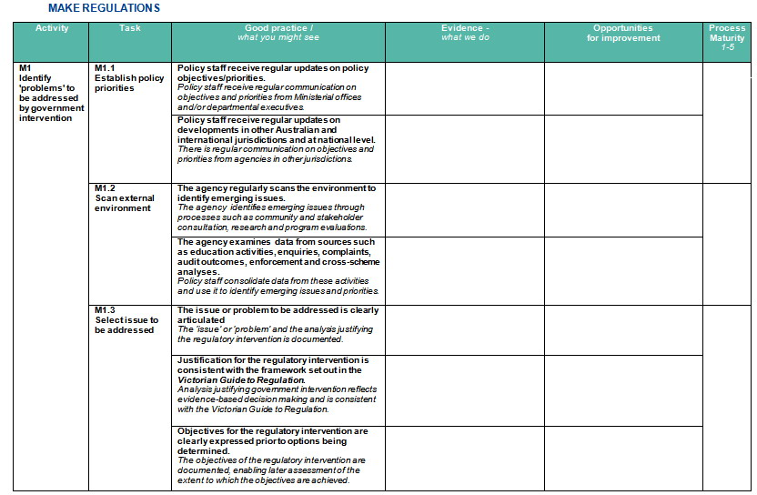
BBR Evaluation Guide

Slide 15
Good practice assessment
‘Do’
‘Partially do’
‘Do not do’

Slide 17
Process maturity

Slide 18
Process Maturity = Level 1
Activity: O1 Educate stakeholders about the regulation
Task: O1.1 Plan educational initiatives
Findings
Articulate the objectives of education and information programs.
  Some documentation of objectives, but not consistent.
  No plans documented (some exist in ad hoc form, e.g. Scheme ‘M’)
Design appropriate initiatives.
  Comprehensive documentation for Scheme ‘C’.
  Some documented for Scheme ‘P’.
  No other schemes with formal descriptions of educational initiatives
Improvement plan
Develop an integrated education plan across all the regulator’s schemes, to achieve:
  Better targeted educational programs; more efficient use of resources; more appropriate and effective modes of delivery.
  Better coverage of potential licensees by information delivery.
  Better informed applicants.
  Better quality applications.

Slide 19
Process Maturity = Level 4
Activity: O4 Respond to complaints
Task: O4.1 Resolve complaints
Findings
Resolve complaints or refer them to the appropriate party for resolution according to formal rules.
  Complaints about granting, denial or revocation of a registration or licence
    All decision letters advise complainants of the review/appeal processes.
    Appeal or reviews to: the Commission; DAs appeal hearings; Supreme Court.
    Persons not legally represented are helped by Commission lawyers.
    Pre-hearings explain the process informally and inform the applicant clearly.
    Every attempt is made to contact attendees.
    Interpreters provided for ESL attendees.
Improvement plan
Strengthen complaint resolution by developing a complaints charter.
  Establish complaints charter and publish publicly.
  Publicise the complaints process and response times to interested parties.
  Make clear roles, rights, responsibilities and response times.

Slide 20
Action plan
Responsibility matrix, good practices performed, process maturity and specific opportunities for improvement identified in the workshop are developed in the second workshop into an action plan.

Slide 21
Final self-evaluation report
Executive summary
Background
Results
  Responsibility matrix
  Good practices
  Process maturity
  Opportunities for Improvement
Action Plan
Attachment
  Workshop data

Slide 22
Lessons learned
Limitations of self-evaluation
Speed vs comprehensiveness
Comprehensiveness vs resources & acceptance
What worked, what could be improved

Slide 23
Variations
Other frameworks
Peer-moderated self-evaluation
External evaluation
Independent audits/awards
Peer review
Images: stock.xchng www.sxc.hu

Slide 24
Conclusions
Robust
Rapid
Broadly applicable
Practical

Slide 25
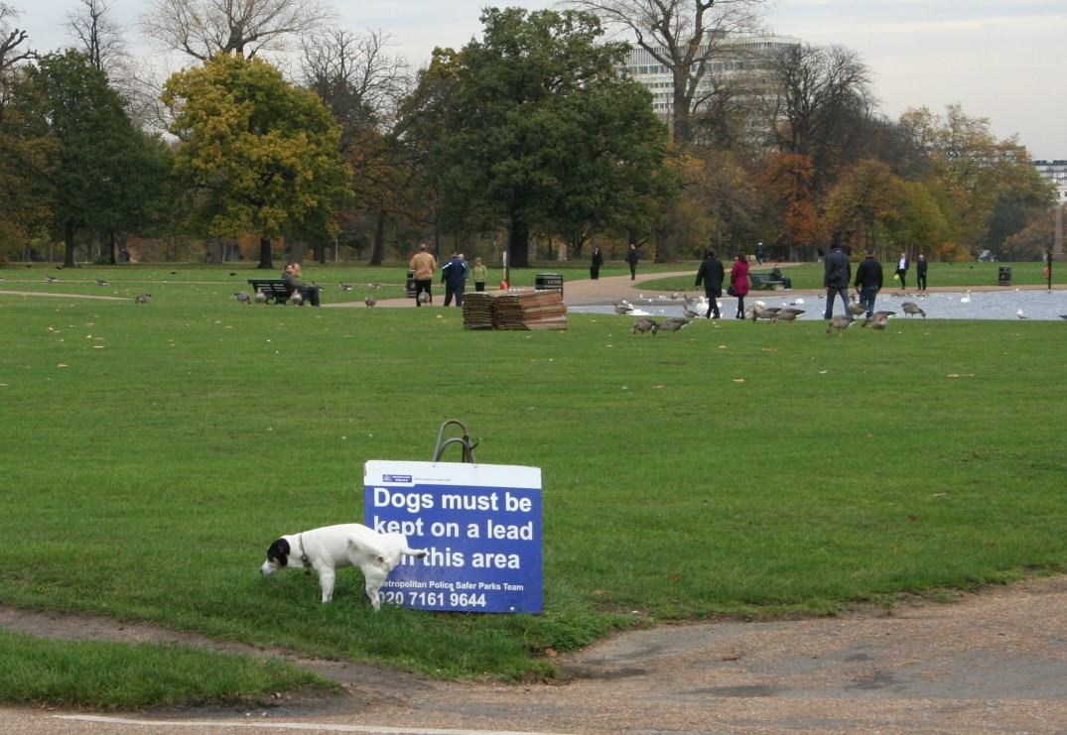
Better Business Regulation
Evaluate the way you regulate
Questions?

